Slide 1
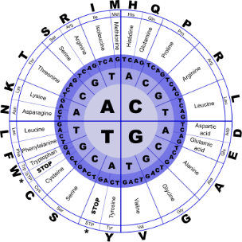
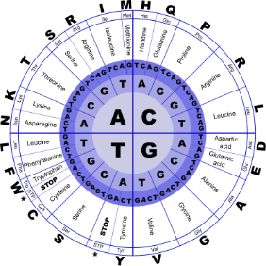


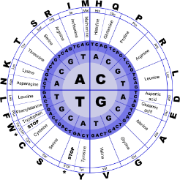
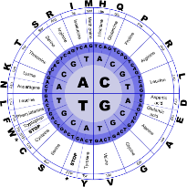
Fundamentals of Programming II
Standard Template Library

Slide 2
Function Templates
Function template: A pattern for creating definitions of functions that differ only in the type of data they manipulate. It is a generic function
They are better than overloaded functions, since the code defining the algorithm of the function is only written once

Slide 3
Function Templates
Two functions that differ only in the type of the data they manipulate
void swap(int &x, int &y)
{ int temp = x; x = y;
y = temp;
}
void swap(char &x, char &y)
{ char temp = x; x = y;
y = temp;
}

Slide 4
Standard Template Library
Standard Template Library (STL): a library containing templates for frequently used data structures and algorithms
Programs can be developed faster and are more portable if they use templates from the STL

Slide 5
Creating Container Objects
To create a list of int, write
list<int> mylist;
To create a vector of string objects, write
vector<string> myvector;
Requires the vector header file

Slide 6
Algorithms
STL contains algorithms that are implemented as function templates to perform operations on containers.
Requires algorithm header file
Collection of algorithms includes
binary_search | count
for_each | find
max_element | min_element
random_shuffle | sort
and others

Slide 7
random-shuffle Example
The following example stores the squares 1, 4, 9, 16, 25 in a vector, shuffles the vector, and then prints it out
16-7

Slide 8
random-shuffle Example
int main()
{
vector<int> vec;
for (int k = 1; k <= 5; k++)
vec.push_back(k*k);
random_shuffle(vec.begin(),vec.end());
vector<int>::iterator p = vec.begin();
while (p != vec.end())
{ cout << *p << " "; p++;
}
return 0;
}

